Slide 1
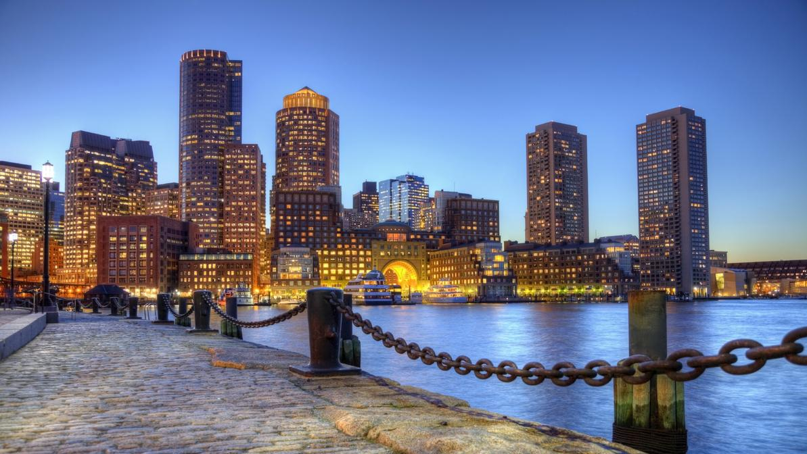
Bring Your Own Water
Devora Najjar and Tricia Shi
Developed by: Avery Normandin and Devora Najjar

Slide 2
Bring Your Own Water
Day I -
Understanding the Marine Microbiome
Notes:
Icebreaker - name + favorite marine organism
What counts as an organism?
Opening Discussion - What is a marine microbiome?

Slide 3
Objectives
1. Contextualize the following terms and concepts within a relevant model system (for example, the photic zone of a marine ecosystem) -
ecology; evolution; biotic and abiotic; community; ecosystem; symbioses (mutualism, commensalism, parasitism); niche; competition; interdependence; diversity
2. Describe complex ecological interactions across scales of size in marine bodies
3. Highlight the importance of the microbiome within the marine ocean ecosystem
4. Discuss how these microbes can be visualized and further characterized

Slide 4
Guiding Questions
1. What is an ecosystem?
2. Where do these ecosystems persist? In the gut? Soil? Ocean?
3. What is the functions of a microbiomes, and more specifically, of the ocean microbiome?
4. How are global changes (climate change; rapid urbanization; pollution; ocean acidification) affecting these systems? What are the long- and short-results of these perturbations? How can they be addressed?
5. What are the broader environmental impacts stemming from microbiome alterations?

Slide 5
What is ecology?
Where is ecology?
What is your relationship, your connection, with ecology?
Notes:
Write on the board.
Where
can reinforce notion of “biome”
can be in unexpected places too like kitchen sink

Slide 6
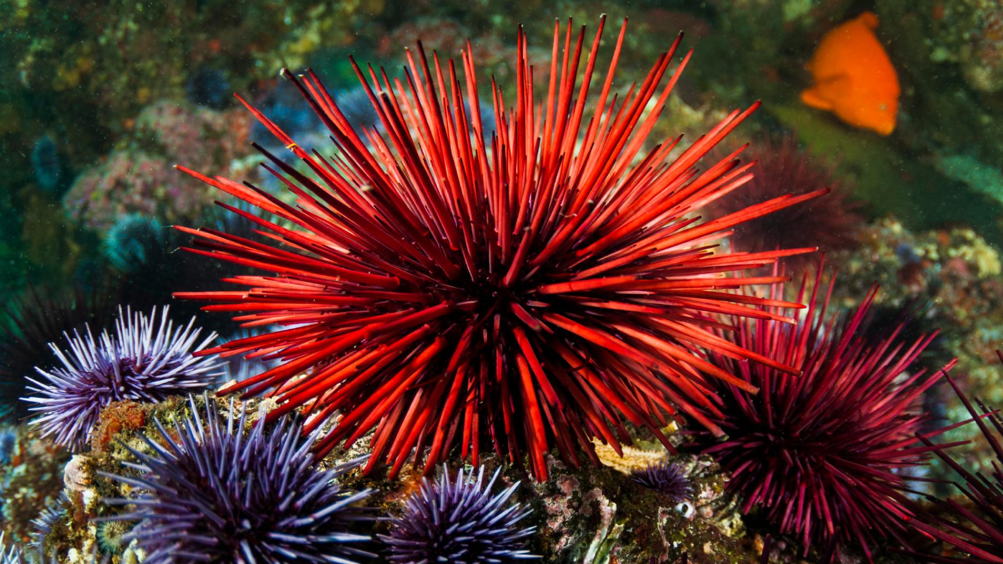
Ecology
concerns
i. interacting and
ii. the transfer or transformation of energy

Slide 7
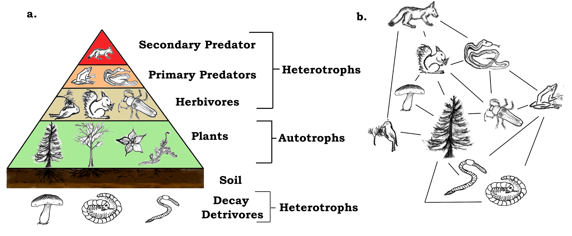
Ecosystem as a complex web

Slide 8
What types of interactions occur in each example?
At what points is energy, currency being transferred, and how? What, exactly, is the energy being transferred?
How do the representations of ecology differ?
What is the role of humans, their processes, in each, if any?
Notes:
Point out things like the sun, exports, information in the second diagram.
The second diagram and is more complex and therefore more like the ocean - things interact at different levels

Slide 9
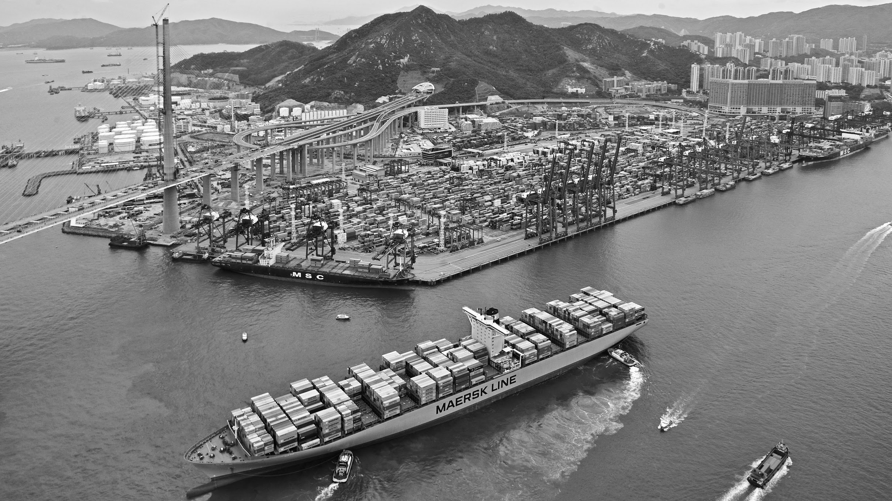
Notes:
What are different interactions?
Biofilming (microorganisms attaching together to create a large, visible film)
Rain (water cycle, e.g. mountain water that carries different organisms/compounds in it)
Industrial Work

Slide 10
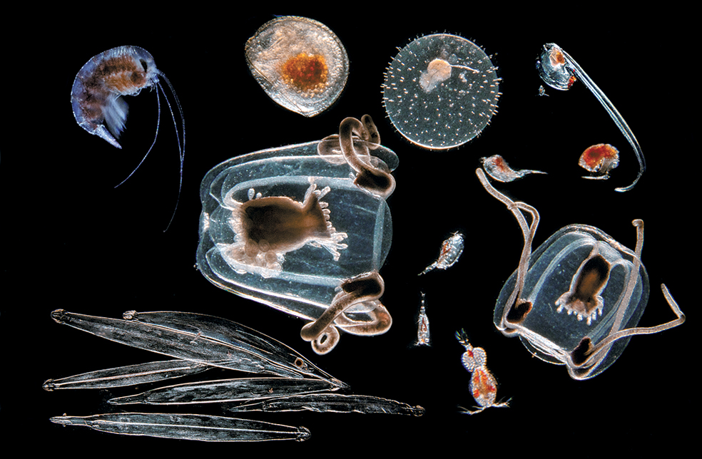
We are at the mercy of microbes.
Notes:
Microbes do photosynthesis and nutrient cycling that are essential for the rest of the ocean.

Slide 11
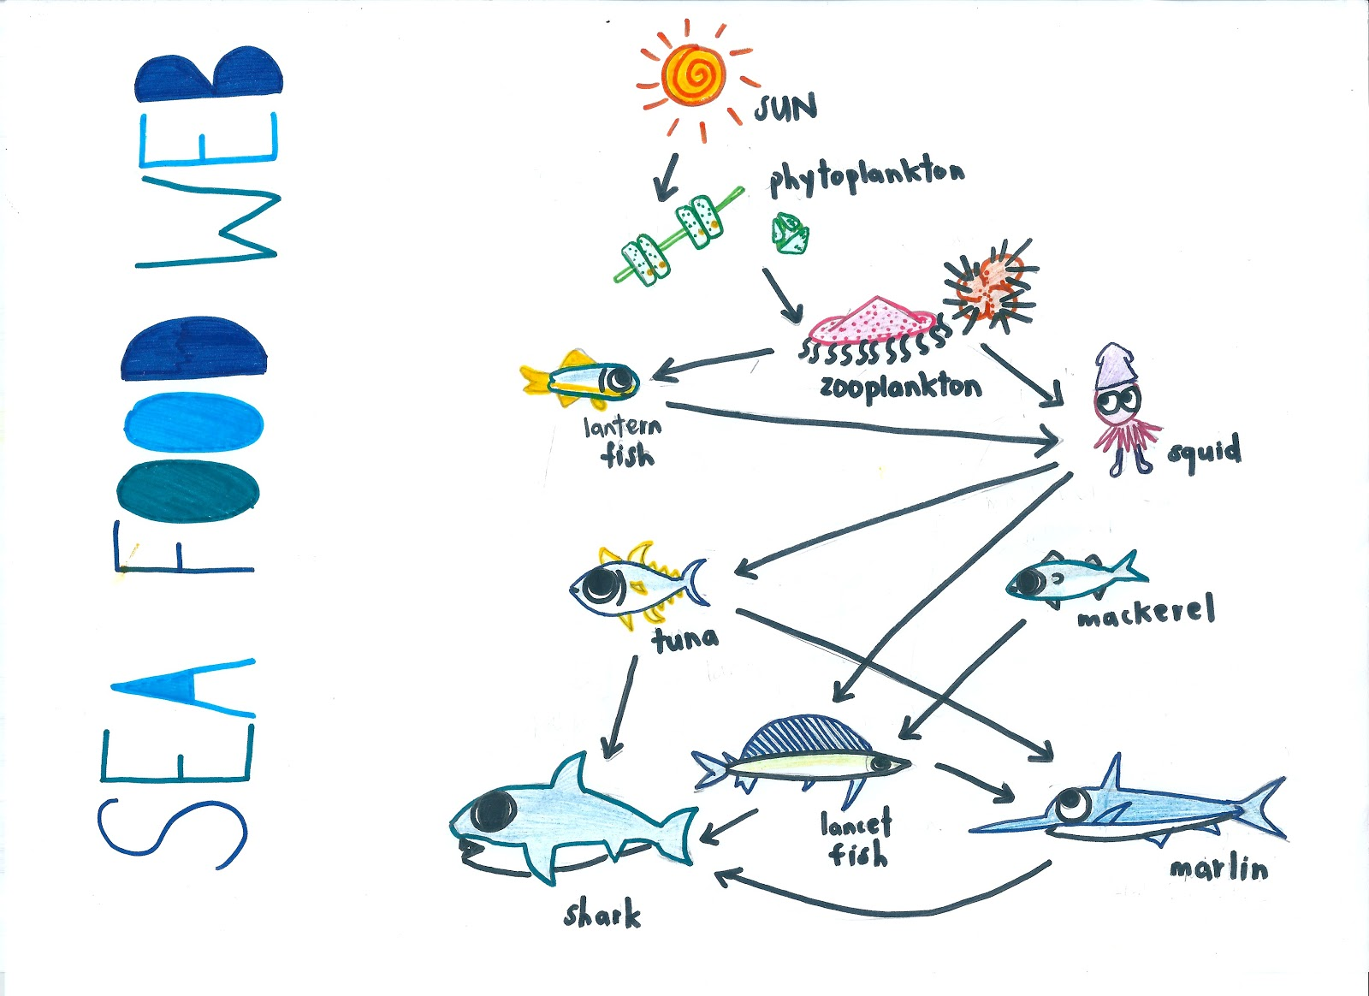
Activity: Drawing the Marine Ecosystem of Hong Kong

Slide 12
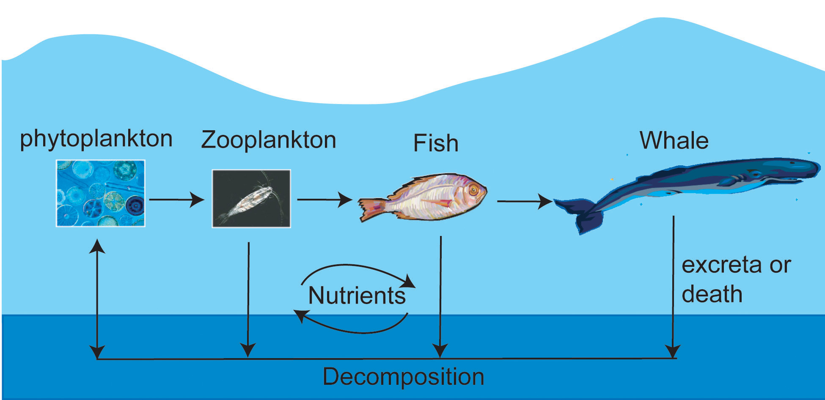
Activity: Scales of the Ocean

Slide 13
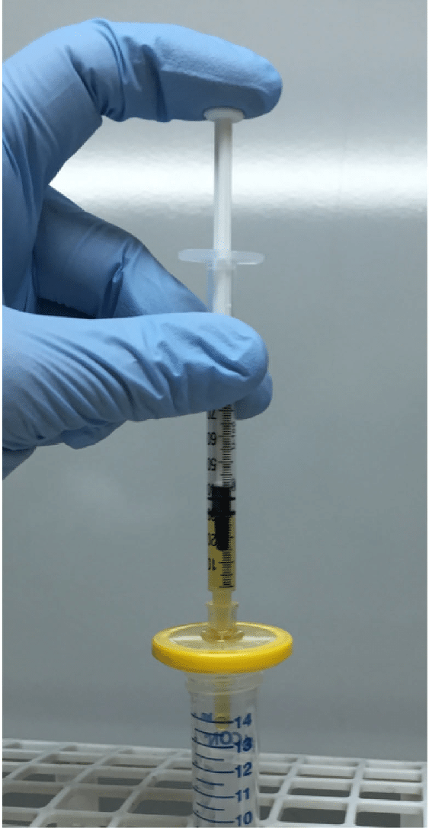
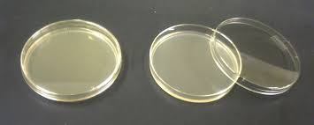
Activity: Culturing Marine Microbes

Slide 14
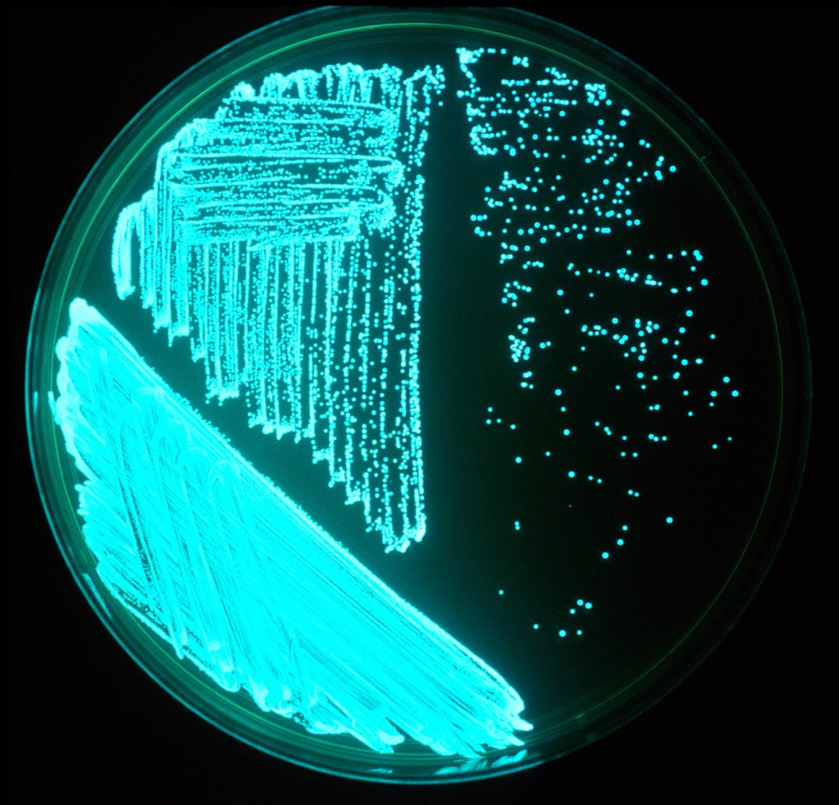
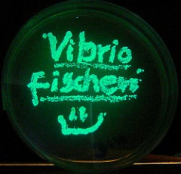
Activity: BioArt with Vibrio fischeri

Slide 15
Day I Schedule
9:30 AM - 9:40 AM Activity: Names + Icebreakers
9:40 AM - 10:00 AM Discussion: Marine microbiology, ecology
10:00 AM - 10:15 AM Activity: “What is an Ecosystem?” Drawings
10:15 AM - 10:30 AM BREAK
10:30 AM - 10:50 AM Activity: Ocean Across Scales
10:50 AM - 11:05 AM Discussion: Debrief activities
11:05 AM - 11:4 5AM Activity: Cultivating Microorganisms, Bio-Art
11:45 AM - 12:00 PM Discussion: Predict cultivation results, Add to ecosystem drawings

Slide 16
Bring Your Own Water
Day 2 -
Diving Deeper into the Marine Microbiome

Slide 17
Objectives
1. Predict how environmental conditions (presence of nutrients, temperature, pH, etc.) impact a marine ecosystem and the organisms it harbors
2. Develop testable hypotheses, as well as design experiments capable of garnering data which address these hypotheses
3. Visualize data in a meaningful, concise, and informative way
4. Present scientific data to a general audience in a compelling manner
5. Speculate future research questions based on preliminary inquiries

Slide 18
Guiding Questions
1. What techniques are used to visualize marine microbes? Are these methods comprehensive, and if not, how can these microbes be accounted for?
2. What are common methods for microbiome monitoring? Are these monitoring methods identical across different environments (soil, water, gut)?
3. How does interest in or question about the marine microbiome turn into a testable hypothesis?
4. How do you decide on the proper scope and parameters of an experiment (sample size, replicates, time points, dilutions)?
5. How do you visualize experimental results in a way that highlights the key information learned through the experiment?

Slide 19
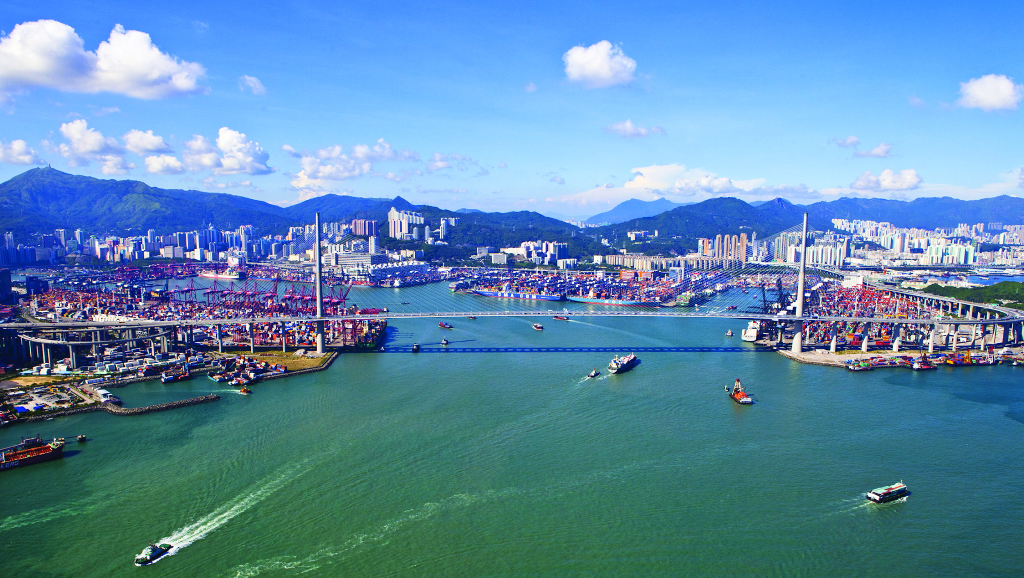
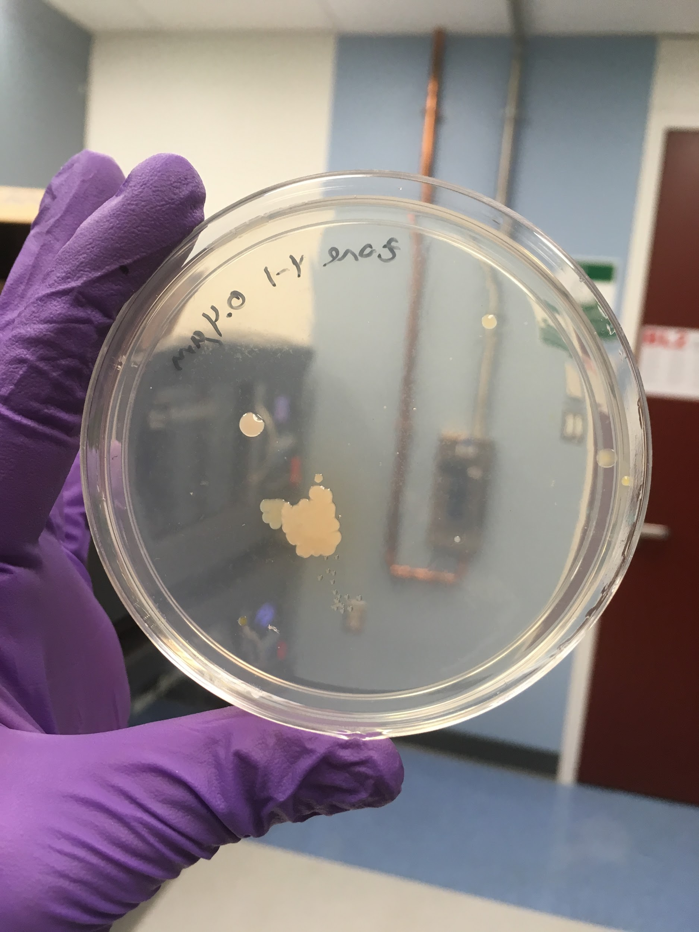
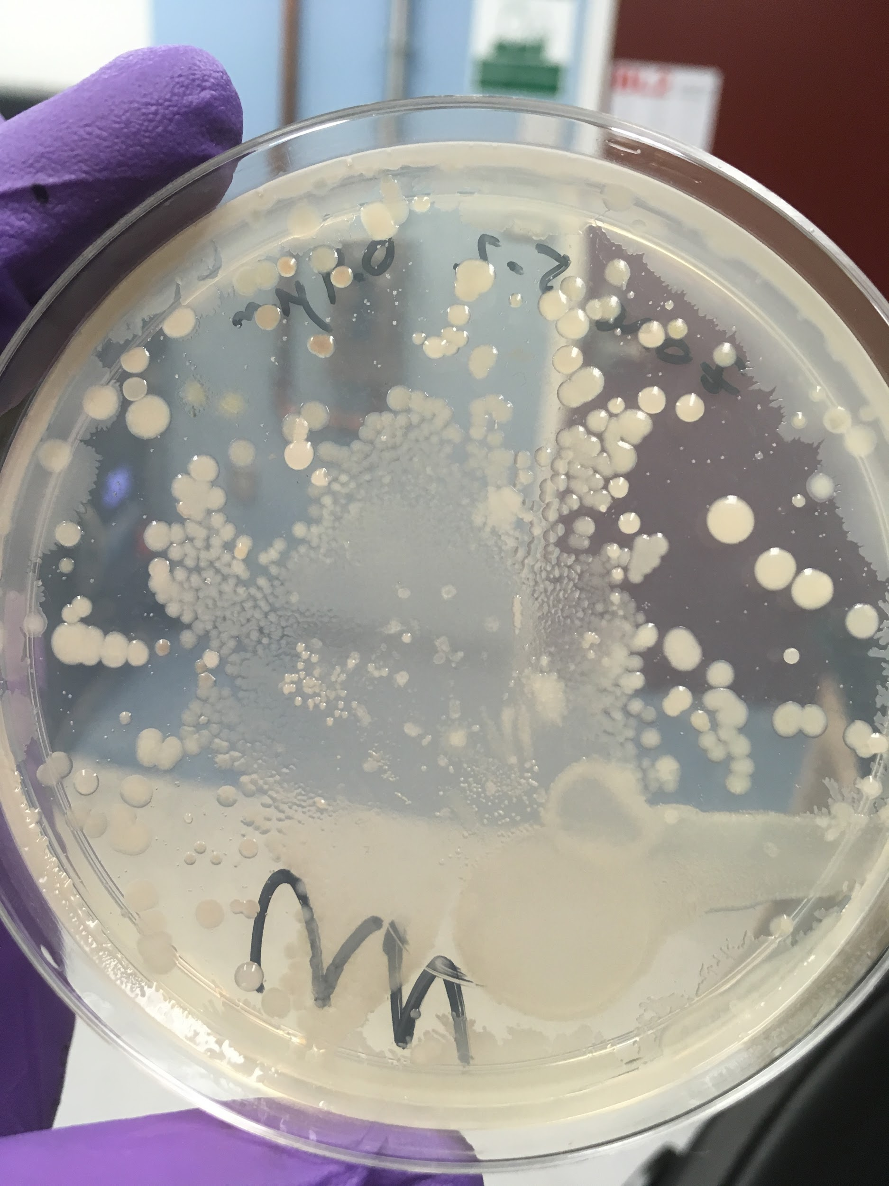
Review: Culturing Marine Microbes
Notes:
Basically, you are trying to re-create the environment that the microbes came from in order to have an environment suitable for the microbes to be grown in.

Slide 20
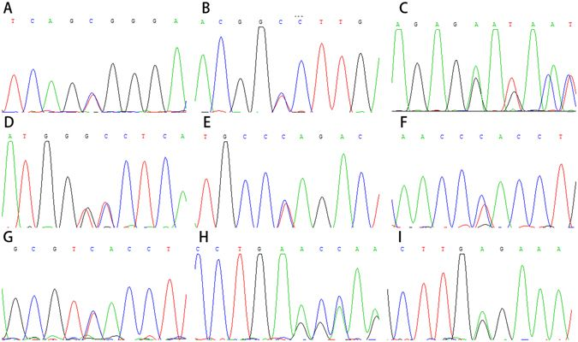
How do we probe the unculturable?
DNA Sequencing technology has vastly improved our ability to understand the multitude of microbes present, because we do not need to culture the sample to get results!
This technique has opened the eyes of scientists how much more vast the microbial world is than we could ever imagine!
Notes:
We can SEQUENCE !

Slide 21
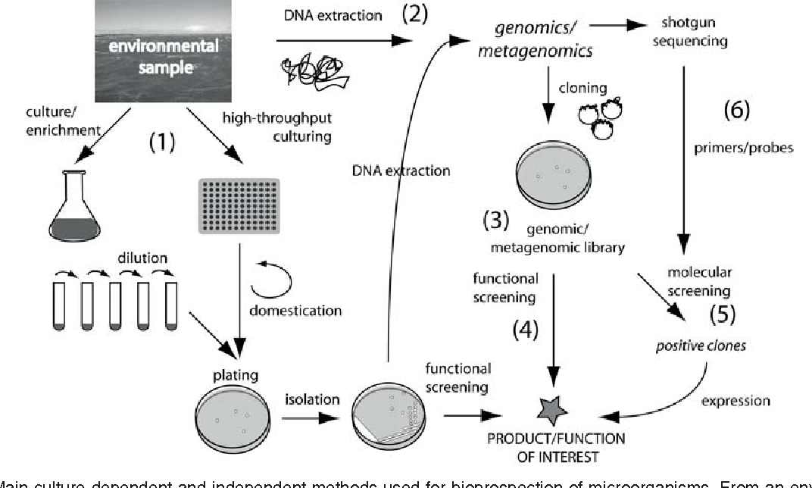
An example workflow
Dionisi, Hebe M., Mariana Lozada, and Nelda L. Olivera. "Bioprospection of marine microorganisms: biotechnological applications and methods." Revista argentina de microbiología44.1 (2012): 49-60.

Slide 22
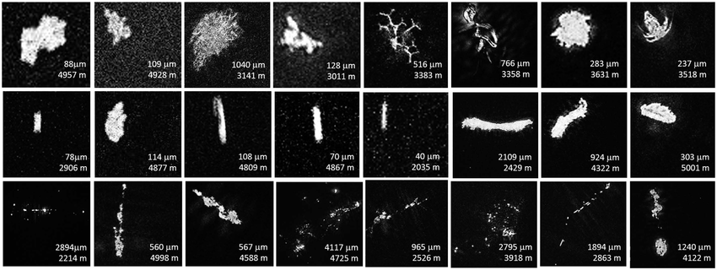
What is considered at the “macroscopic” scale?
Macroscopic particles are anything that can be seen with the naked eye (no magnification!)
It’s usually anything found in the ocean that is 1mm or larger

Slide 23
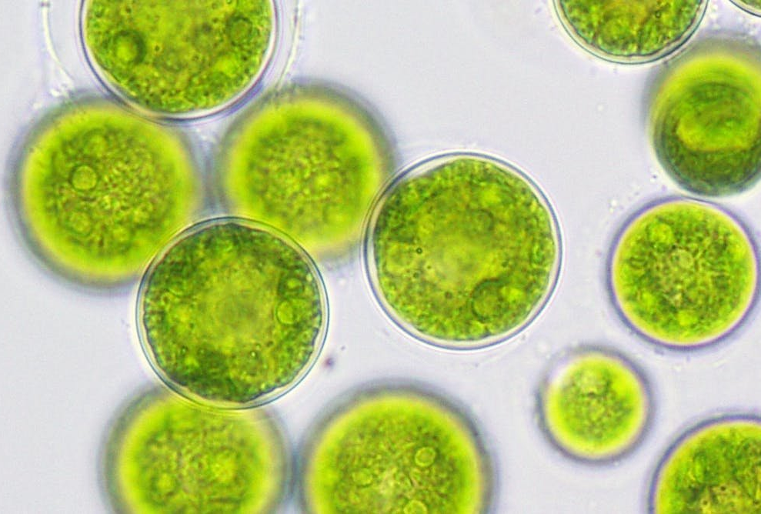
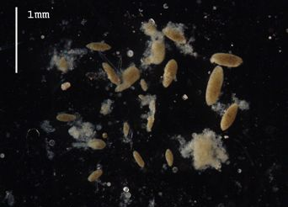
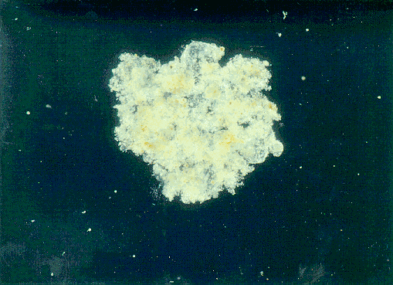
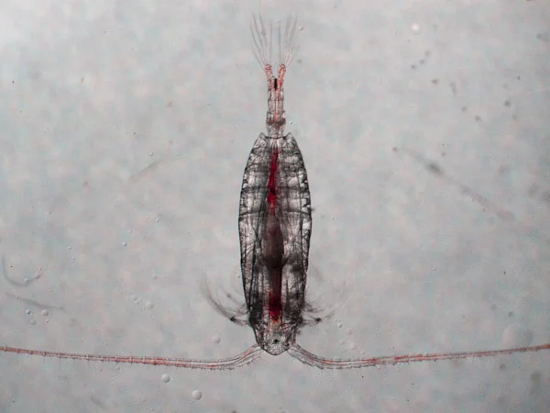
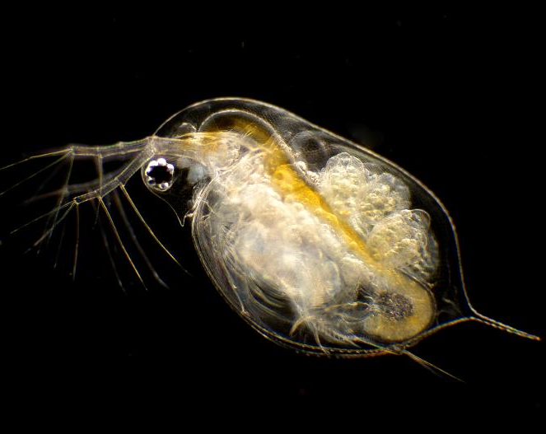
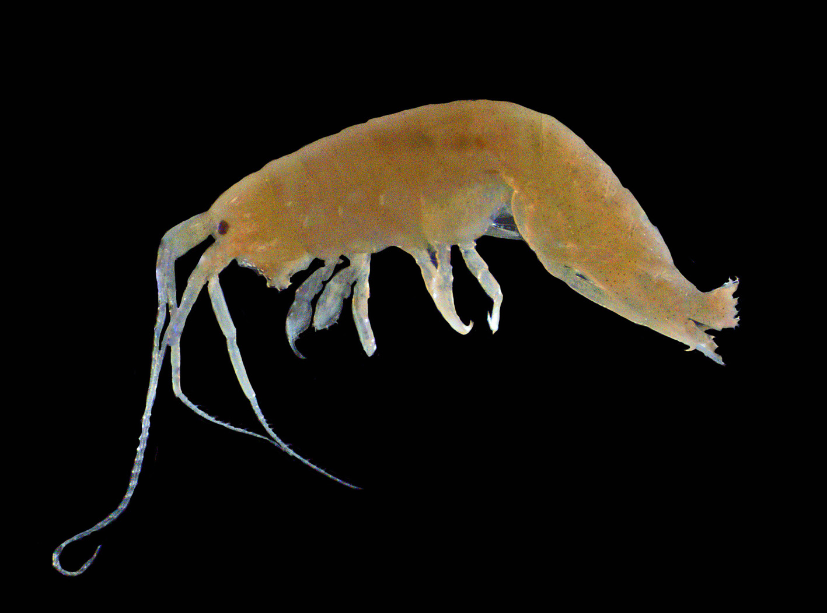
Macroscopic Marine Particulates
Algae
Fecal pellets
Marine snow
Copepods
Daphnia
Amphipods

Slide 24
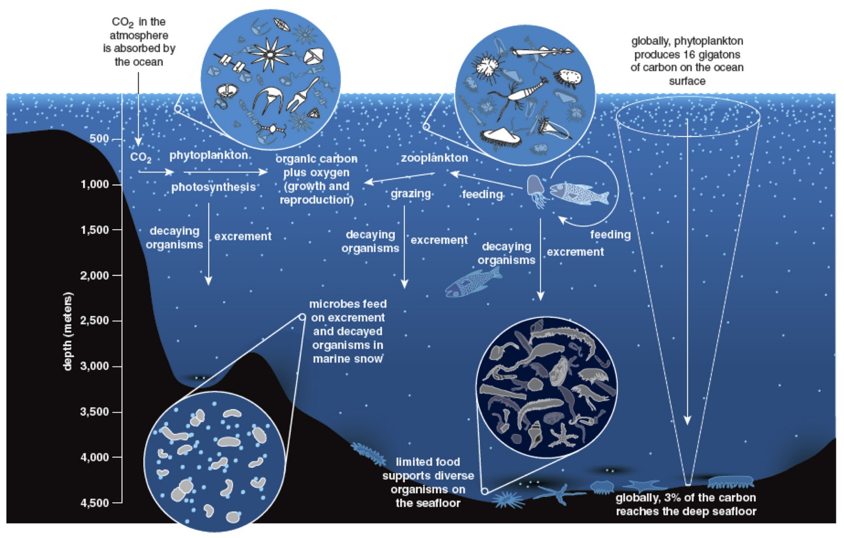
Carbon Cycle
http://mostlyopenocean.blogspot.com/2012/01/deep-sea-diversity.html

Slide 25
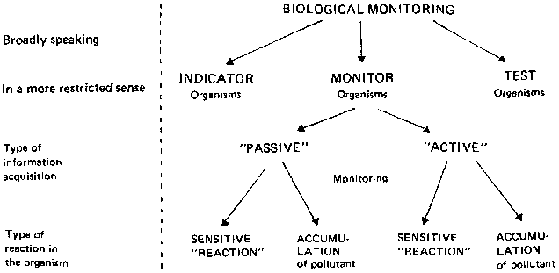
Bioindicators
Ellenberg, Hermann, et al. Biological monitoring: signals from the environment. No. 333.95 B615bi. GTZ, Eschborn (Alemania), 1991.

Slide 26
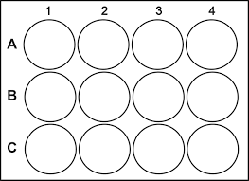
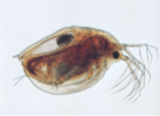
Activity: Bioindicators
Set up controls for the experiment &
develop a hypothesis
Test environmental stimuli to see how it affects the Daphnia
Example stimuli:
Heat
Citric acid
Salt
Caffeine

Slide 27
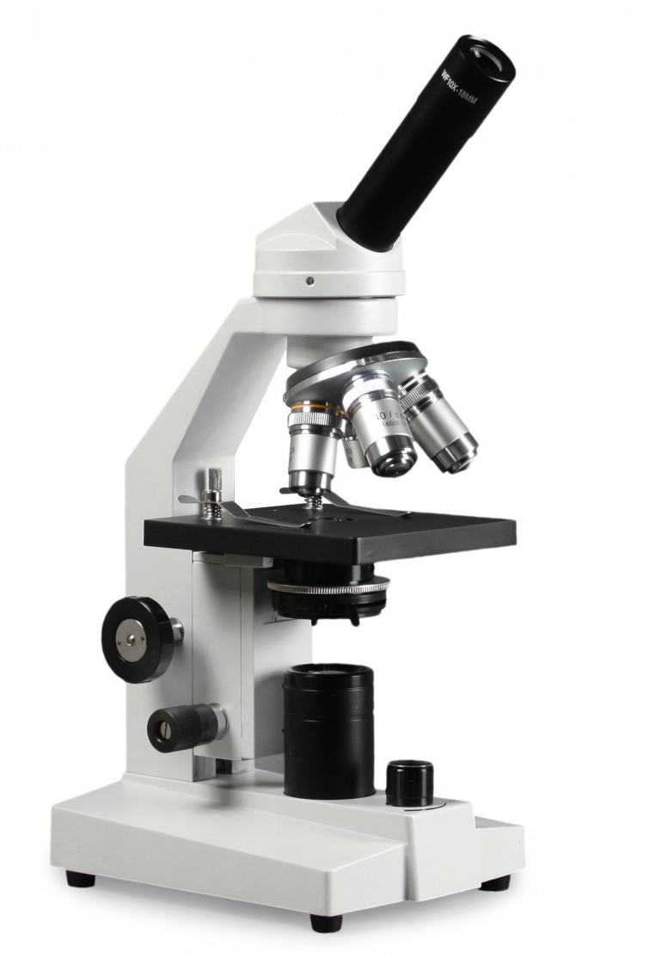
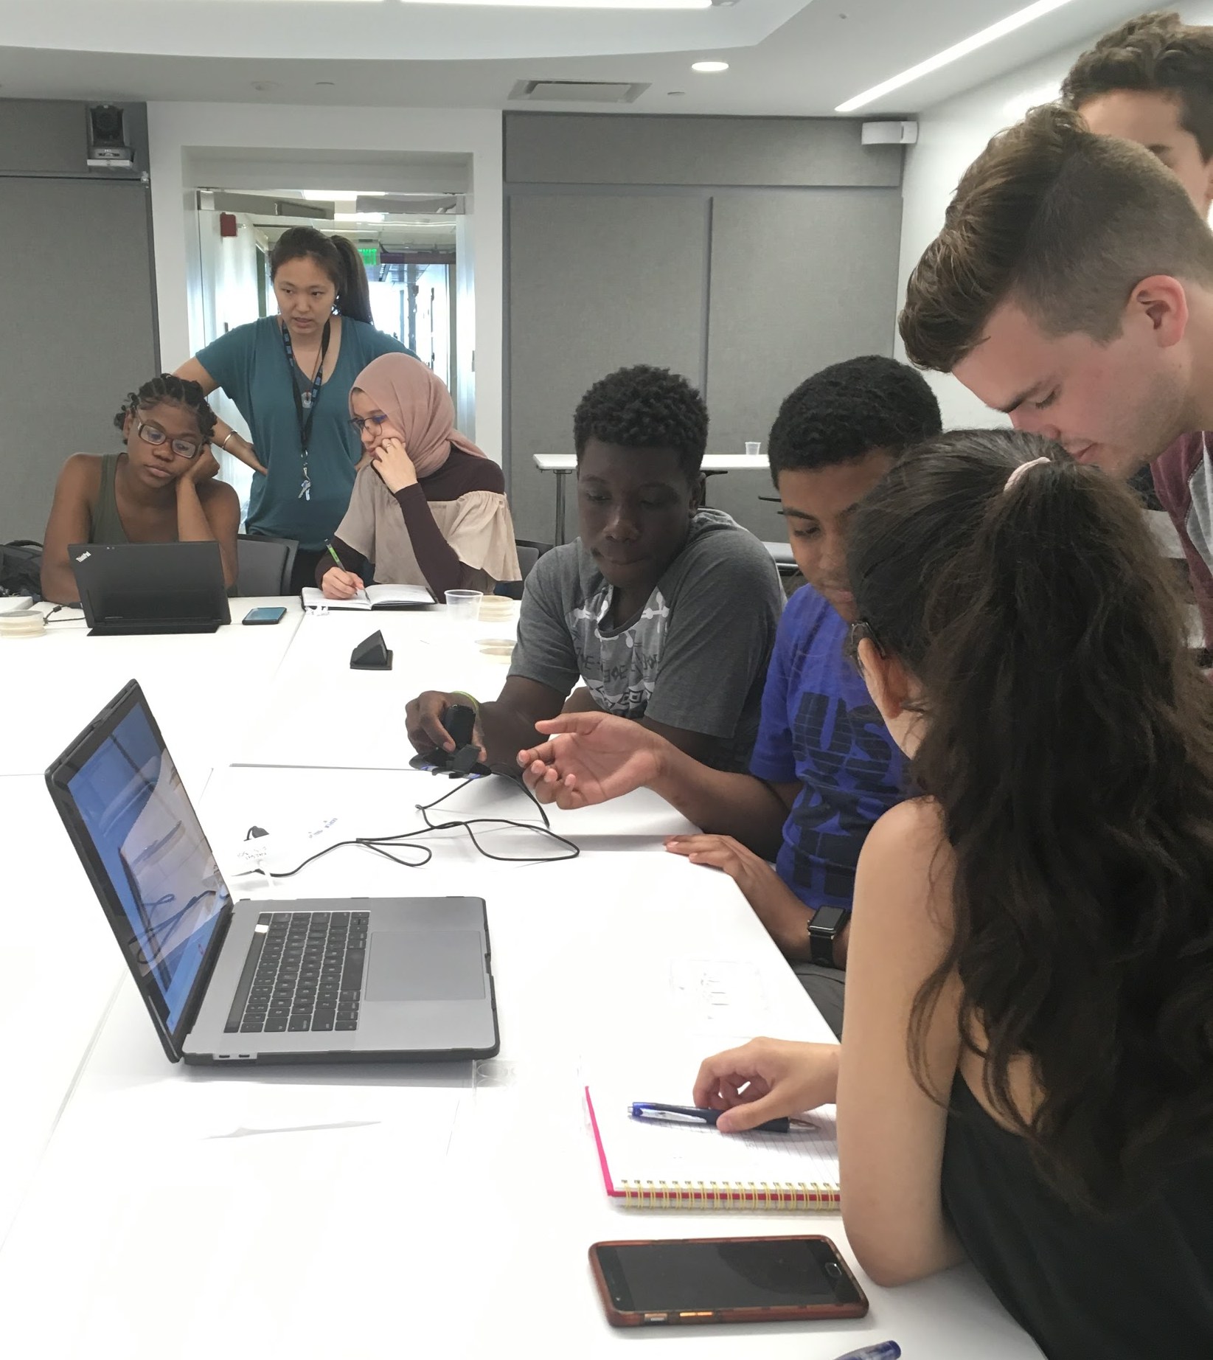
Activity: Bioindicator
Light Microscope
Webcam Microscope

Slide 28
Day II Schedule
9:35 AM - 9:40 AM Review Vocab + Key Concepts from Day 1
9:40 AM - 9:50 AM Lesson: Culture Techniques and Limitations
9:5 0AM - 10:00 AM Review results of plates
10:00 AM - 10:15 AM Lesson: Macroscopic particles in aquatic environments
10:15 AM - 10:30 AM BREAK
10:30 AM - 10:45 AM Introduce Daphnia Activity, Discuss Bioindicators
10:45 AM - 10:55 AM Arrange groups for experiments, Set up cameras
10:45 AM - 11:45 AM Daphnia Experiment
11:45 AM - 12:00 PM Debrief Activity, Discuss impact of environmental factors

